Slide 1
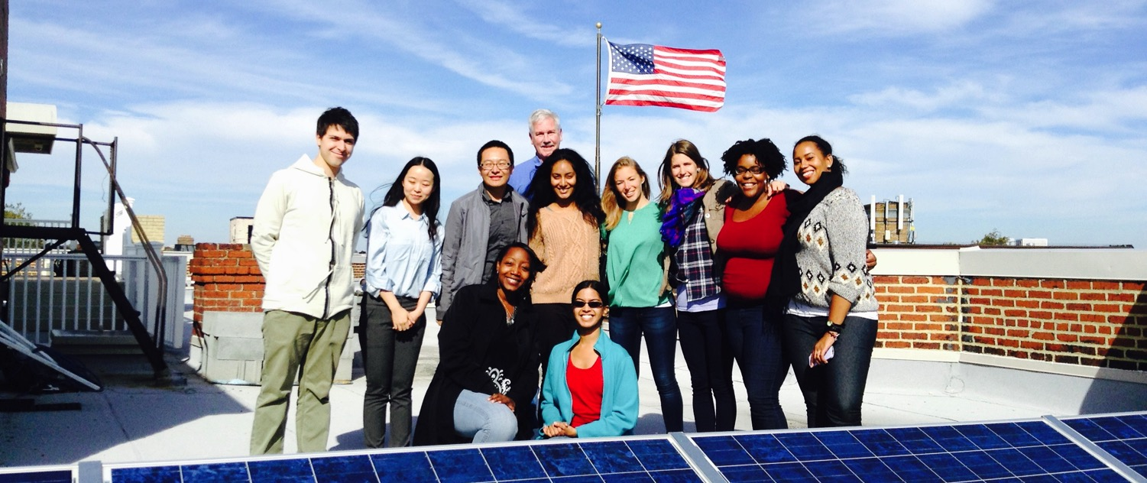
Introduction to Solar PV
2019 West Virginia Solar Congress
April 27, 2019

Slide 2
Presentation in three parts:
Solar technology
How solar co-ops work
Solar economics

Slide 3
Part 1: Solar technology

Slide 4
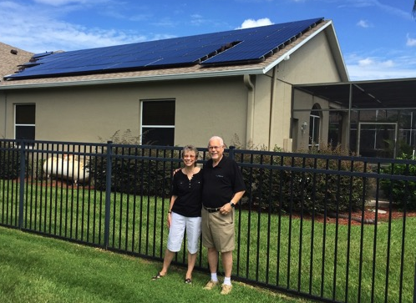
Part 1: Solar Technology
How does a solar panel work?
Solar photovoltaic (PV)
Converts solar energy to electricity

Slide 5
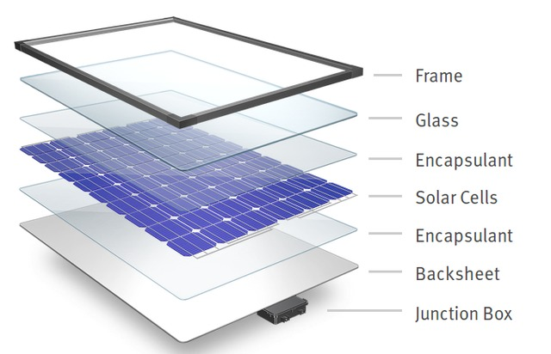
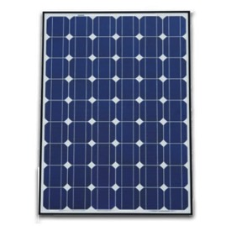
Part 1: Solar Technology
System components: Panels
Solar Array
Panel / Module
Image Source: DuPont

Slide 6
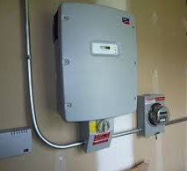
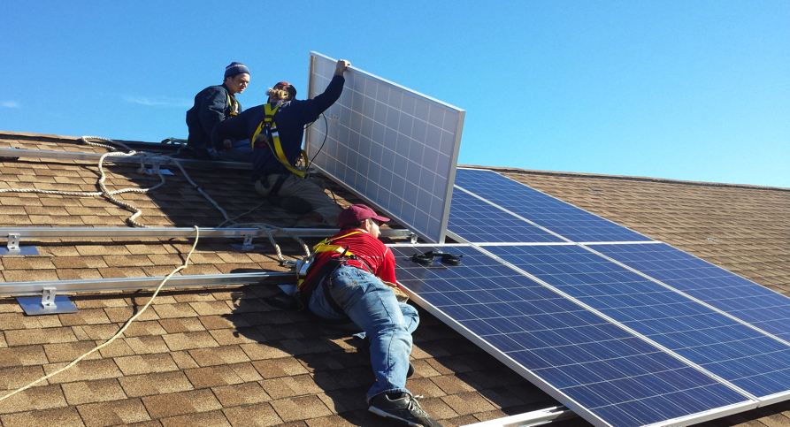
Part 1: Solar Technology
System components:
Inverter & Racking
Inverter
Racking system

Slide 7
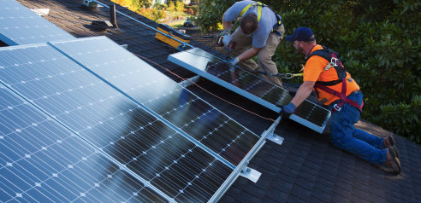
Part 1: Solar Technology
How does solar connect to my roof?
Source: Huffington Post

Slide 8
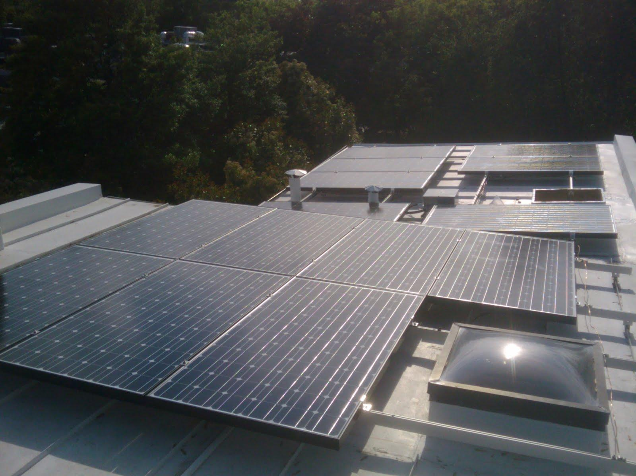
Part 1: Solar Technology

Slide 9
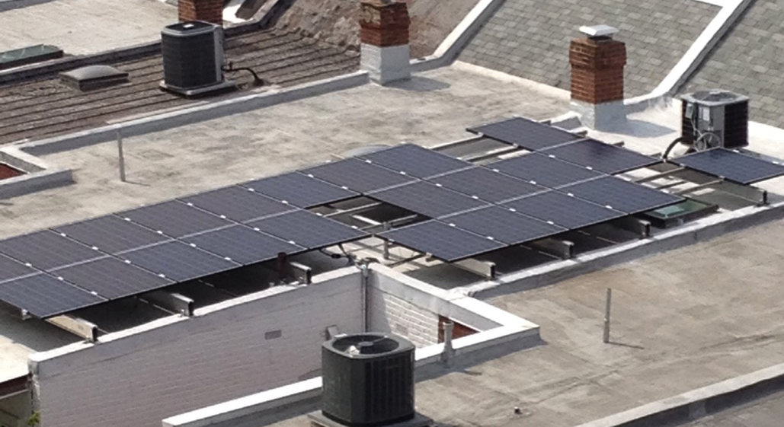
Part 1: Solar Technology

Slide 10
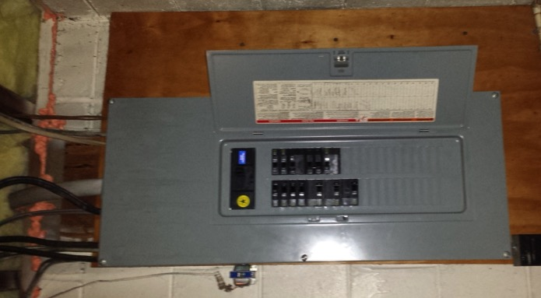
Part 1: Solar Technology
How does it connect to my electrical panel?
Simple connection, most home electric systems don’t need upgrades before solar

Slide 11
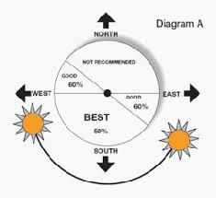
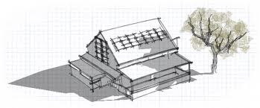
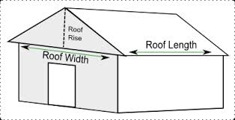
Part 1: Solar Technology
What makes a site good for solar?
No shading
Roof faces southerly direction
Enough space to mount panels

Slide 12
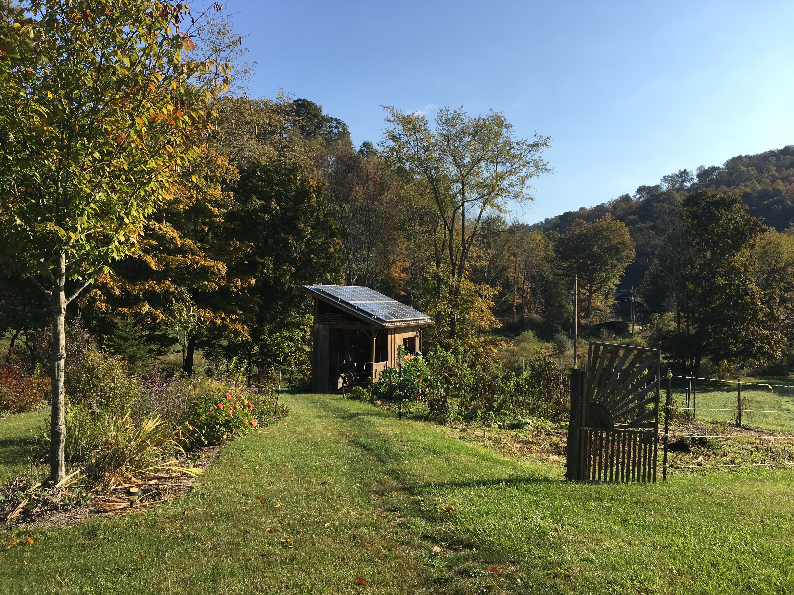
Part 1: Solar Technology
Autumn’s solar garden shed

Slide 13
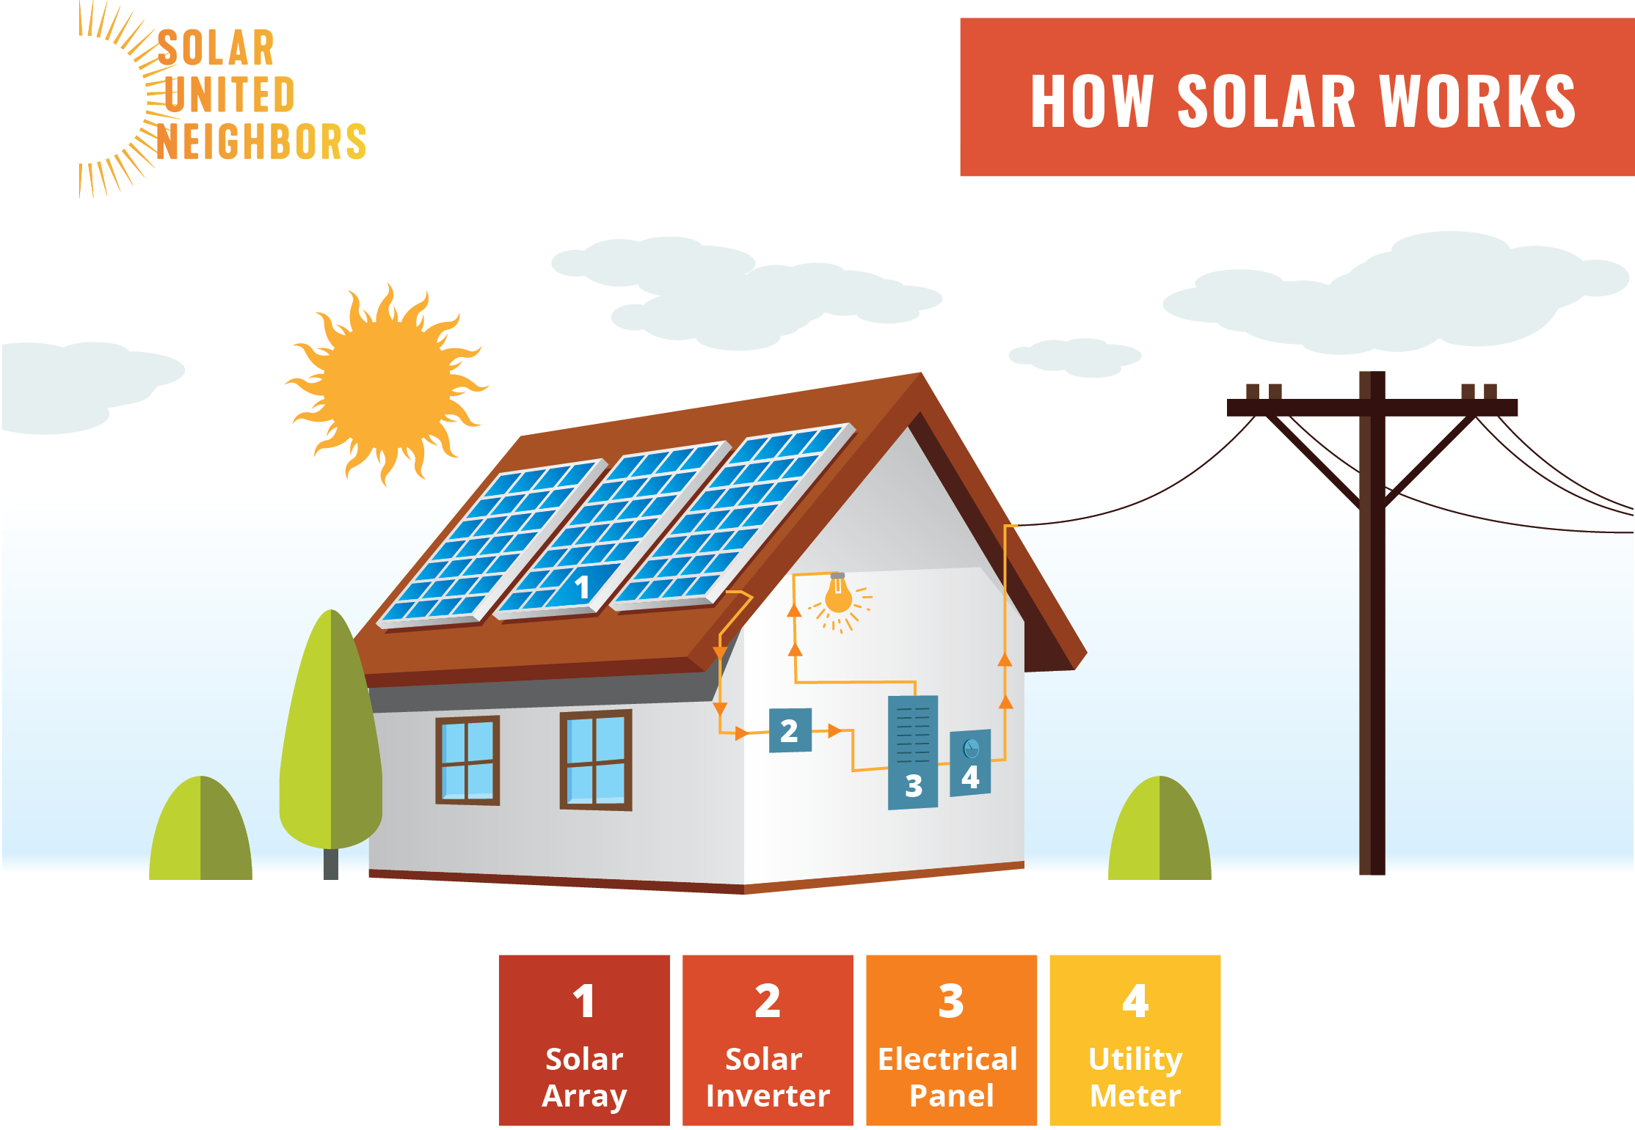
Part 1: Solar technology

Slide 14
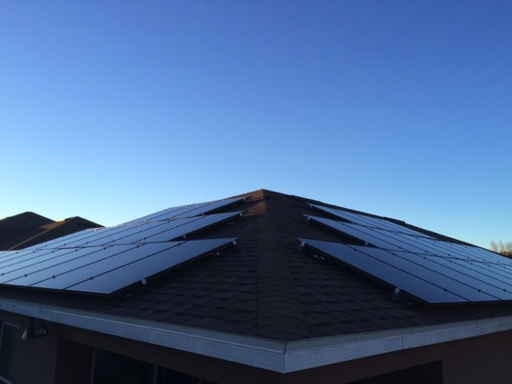
Part 1: Solar Technology
What is net metering?
Allows flow of electricity to AND from customer
When generation is more than use, extra electricity flows back through meter
You receive a credit on your power bill for that excess production

Slide 15
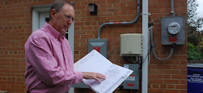
Part 1: Solar Technology
Net metering, continued
Monthly electric bill:
[Amount electricity used] – [Amount electricity produced]
Utilities required by law to let you net meter

Slide 16
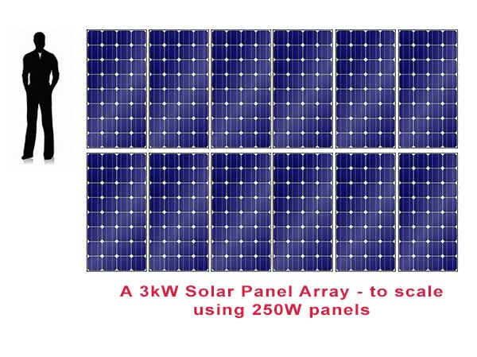
Part 1: Solar Technology
Terminology: Kilowatts (kW) & Kilowatt-hours (kWh)
System measured in kW
Electricity production measured in kWh
Most homeowners install between 2 kW – 12 kW

Slide 17
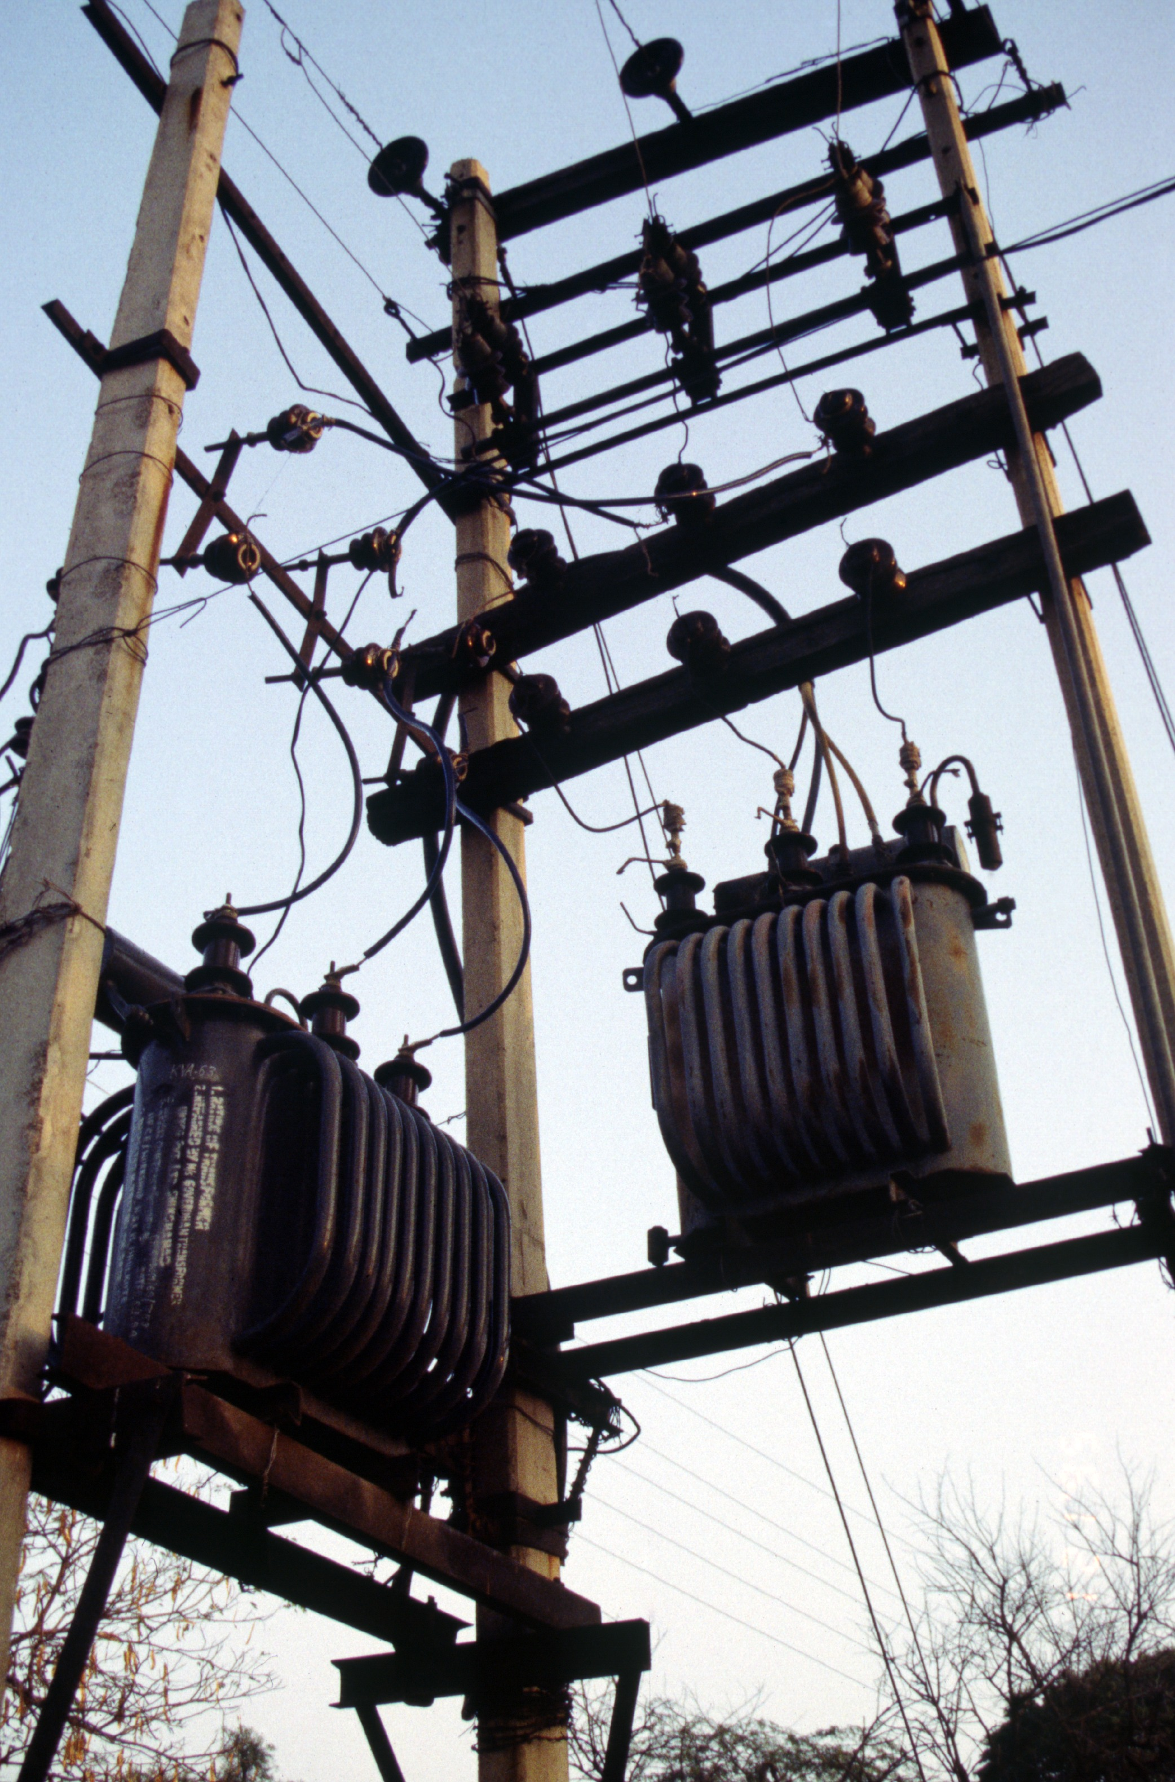
Part 1: Solar Technology
What happens when the power goes out?
When grid is down, solar shuts off (safety mechanism)
Need batteries if you want you want power during outages

Slide 18
Part 1: Solar Technology
Frequently asked questions
Warranties?
Homeowners’ insurance?
Maintenance?
How long do systems last?
Will HOA allow solar on my home?
What if I’m In a historic district?

Slide 19
Part 2: How Solar
Co-ops Work

Slide 20
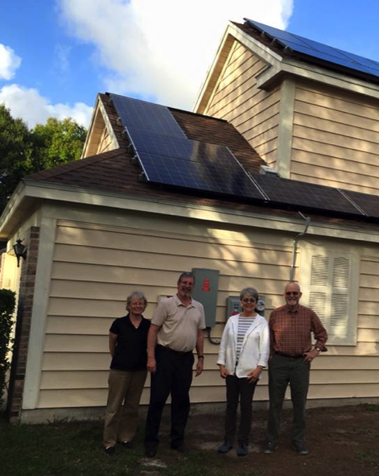
Part 2: How Solar Co-ops Work
Solar co-op benefits
Get best value on installation and support throughout the process
Connect with fellow solar enthusiasts
Become part of the growing solar movement

Slide 21
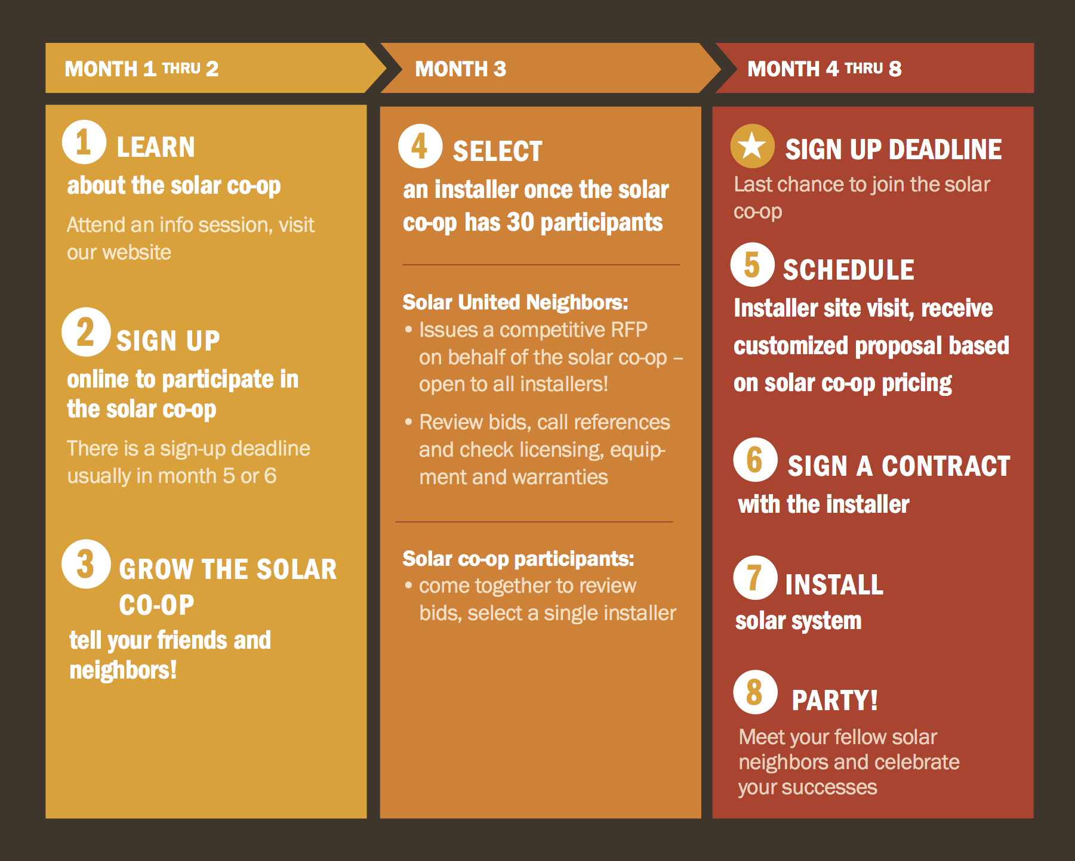
Part 2: How Solar Co-ops Work

Slide 22
Part 2: How Solar Co-ops Work
Who picks the installer? Co-op members
Co-op participants select specific installer criteria including:
Price
Equipment quality
Warranties
Are a local company

Slide 23
Part 3: Solar Economics

Slide 24
Part 3: Solar Economics
A few considerations
Solar is priced by the watt (not by panel)
$9000 / 3000 Watts (i.e. 3kW) = $3/Watt
Solar is long-term
No moving parts & at least 25 year lifespan
Average residential electricity rate in WV
10-12 year payback time
Rising energy prices
increased value for your solar array

Slide 25
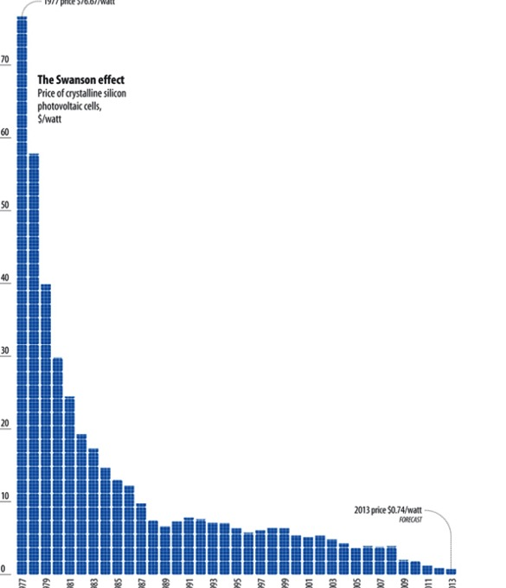
Part 3: Solar Economics
Solar is a great investment!
Costs have dropped 73% since 2010*
No longer a specialty or boutique project
Excellent ROI
30% federal tax credit (steps down after 2019)
1970’s 2013
*Source: International Renewable Energy Agency

Slide 26
Residential PV Cost Summary 2010 - 2017
Residential PV Cost Summary 2010 - 2017
$/W
Assumptions: 5.7 kW system size, adjusted for inflation, national data.
Citation: Fu, Ran, David Feldman, and Robert Margolis. 2017. “U.S. Solar Photovoltaic System Cost Benchmark Q1 2017.” NREL/TP-6A20-68925. Golden, CO: National Renewable Energy Laboratory (NREL). https://www.nrel.gov/docs/fy17osti/68925.pdf.

Slide 27
Part 3: Solar Economics

Slide 28
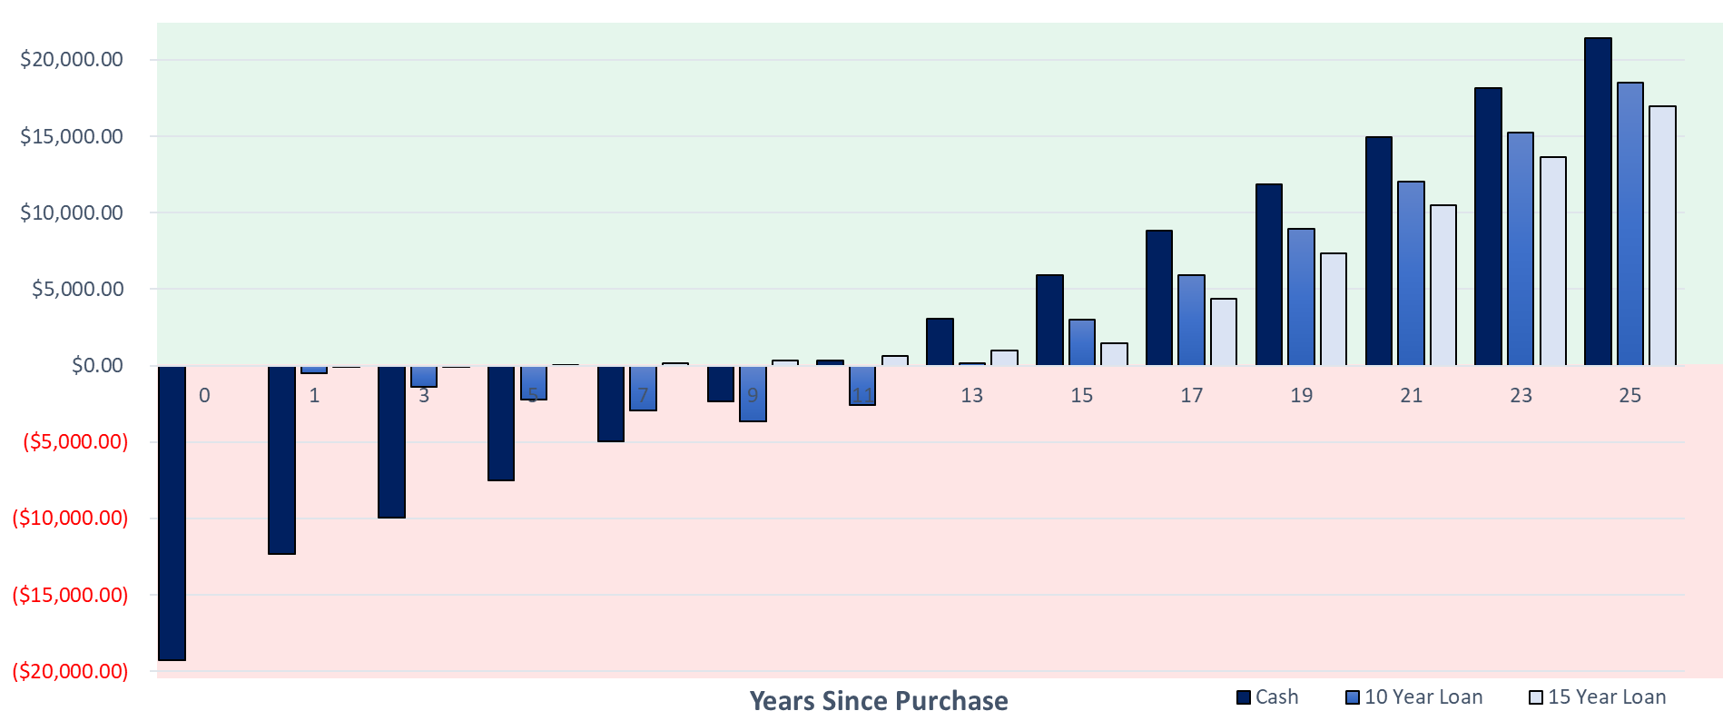
Cumulative Savings with Solar
Cost of solar system after 30% Tax Credit
30% Federal tax credit
Assumptions
SRECs not included, 2% energy increase per year, 7kW System Size, Base Price $2.75/W, 1336 yearly production of 1kW, $0.1243 starting electricity rate, -0.5% panel degradation per year, 4% Interest rate on loan, 70% of cost covered by loan , $0 Operations and Maintenance over system lifetime
Notes:
Photo copy – wont change with excel sheet

Slide 29
Part 3: Solar Economics
Financing
Loans
Standard loans
Solar loans & bridge loans
HELOC
Grants
REAP (USDA Rural Energy for America Program)

Slide 30
What’s Next?

Slide 31
What’s Next?
Join the Charleston-Huntington Solar Co-op
www.solarunitedneighbors.org/charleston-huntington
Join the Solar United Neighbors of West Virginia Facebook Group:
www.facebook.com/groups/SolarUnitedNeighborsofWestVirginia
Spread the word!

Slide 32
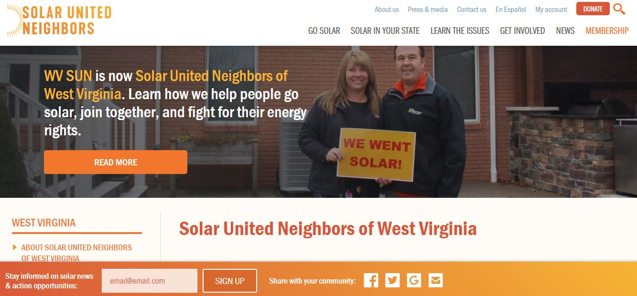
Useful Resource
www.solarunitedneighbors.org/westvirginia

Slide 33
Thank You!
Autumn Long, Program Director
Solar United Neighbors of West Virginia

