Slide 1
Notes:
Image source:https://www.energy.gov/articles/quiz-test-your-solar-iq

Slide 2
BACKGROUND
Green Building Act
Energy Benchmarking and DC SEU
Community Renewables Act
Green Codes
Renewable Portfolio Standard Update
Energy Efficiency Financing Act
Distributed Generation Amendment Act
2006
2008
2010
2011
2013
2014
2016
Creation of Green Building Fund.
Set minimum green building standards for public & private buildings
Launched benchmarking and disclosure program
Enabled community solar
Adopted 2012 International Green Construction Code Creation of Solar for All
Creation of
DC PACE
Localized RPS included Solar Thermal as Tier1
Creation of Solar For All
@DOEE_DC
Notes:
2

Slide 3
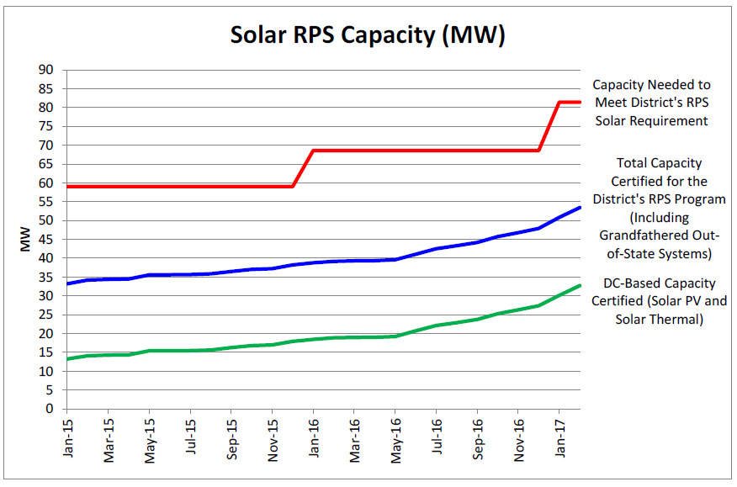
RENEWABLE PORTFOLIO STANDARD & LOCAL SOLAR GENERATION
DC PSC Report Pursuant to the Renewable Portfolio Expansion Amendment Act of 2016. 3/1/2017
@DOEE_DC
Notes:
3

Slide 4
THE DISTRICT HAS THE HIGHEST FINANCIAL INCENTIVES FOR INSTALLING SOLAR
@DOEE_DC
Notes:
4

Slide 5
Serve 100,000 low-income households & cut their electric bills by an amount equivalent to at least 50% of the District’s average residential electric bills.
Task Force of stakeholders informed the development of the Solar for All Implementation Plan.
@DOEE_DC
Notes:
5

Slide 6
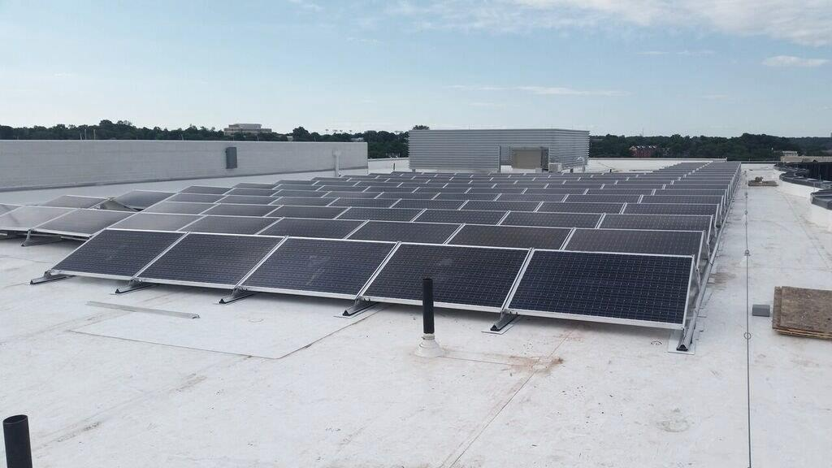
BARRIERS TO SOLAR IN DC
Customer Acquisition and
Management
Customer Education
and
Workforce
Development
Lack of Real Estate
Lack of Willing Host
@DOEE_DC
Notes:
6

Slide 7
ACTIVITIES FUNDED IN FY 2017
Projects by
sister agencies and institutions
Lead by example:
community solar,
resiliency, and innovation
Grants for solar developers
Job training
Solar Works DC
$23+ million awarded in FY 2017
@DOEE_DC
Notes:
7

Slide 8
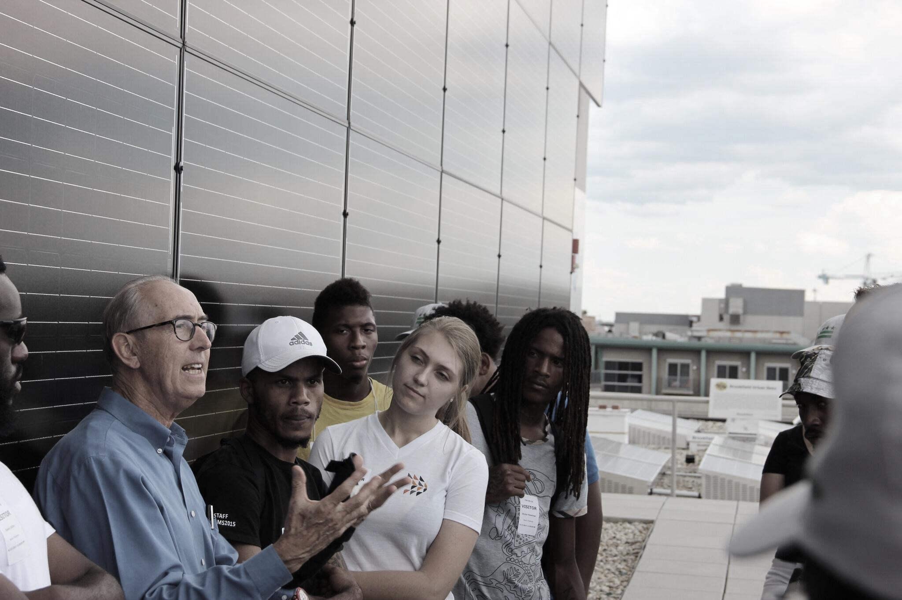
Community Solar Pilot Project
First CREF in the District.
New Partners Community Solar Corp. installed 187 kW, serving approximately 100 income-qualified households.
@DOEE_DC

Slide 9
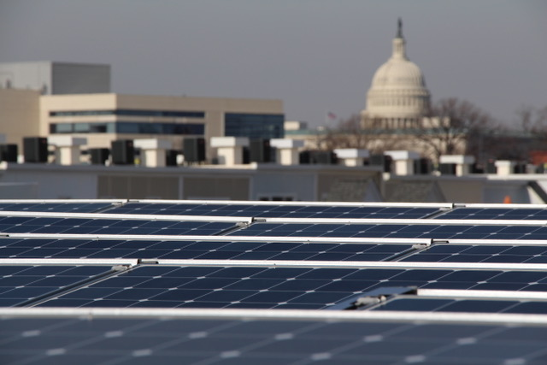
INNOVATION GRANTS
$5M for small businesses, nonprofits, and low-income single-family homes
$8M for multifamily, commercial, and institutional buildings and non-residential surface spaces
Generate solutions to solar barriers
Community solar and co-op projects
@DOEE_DC

Slide 10
INNOVATION AND EXPANSION GRANTEES
GRANTEE NAME: | PROJECT DESCRIPTION:
Solar United Neighbors of DC | 750 kW, serving at least 215 households.
Groundswell, Inc. | 366 kW, serving up to 122 households.
New Partners Community Solar Corp. | 1 MW, serving at least 325 households.
Urban Energy Advisors | 1 MW, serving up to 402 households.
PEER Consultants, P.C. | 500 kW, serving 100 households.
Neighborhood Solar Equity, LLC | 595 kW, serving up to 100 households.
Open Market ESCO | 548 kW, serving 195 households.
Ethos Strategic Consulting, LLC | 1 MW, serving up to 350 households.
Community Preservation and Development Corporation (CPDC) | 1 MW, serving 2,800 households.
@DOEE_DC
Notes:
10

Slide 11
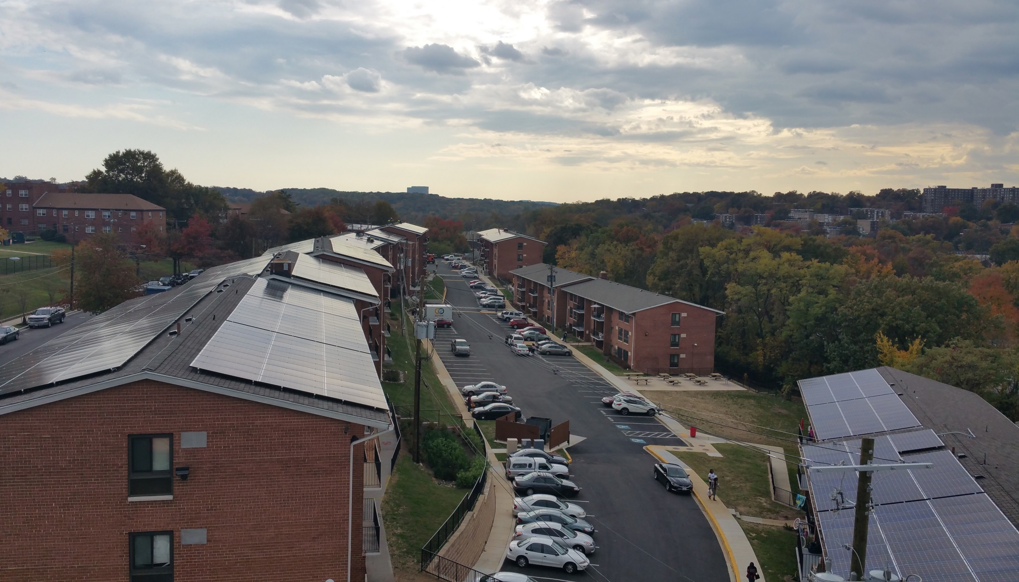
EARLY SUCCESSES:
OPEN MARKET ESCO’S 651 KW COMMUNITY SOLAR PROJECT
$5M for small businesses, nonprofits, and low-income single-family homes
$8M for multifamily, commercial, and institutional buildings and non-residential surface spaces
Generate solutions to solar barriers
Community solar and co-op projects
@DOEE_DC

Slide 12
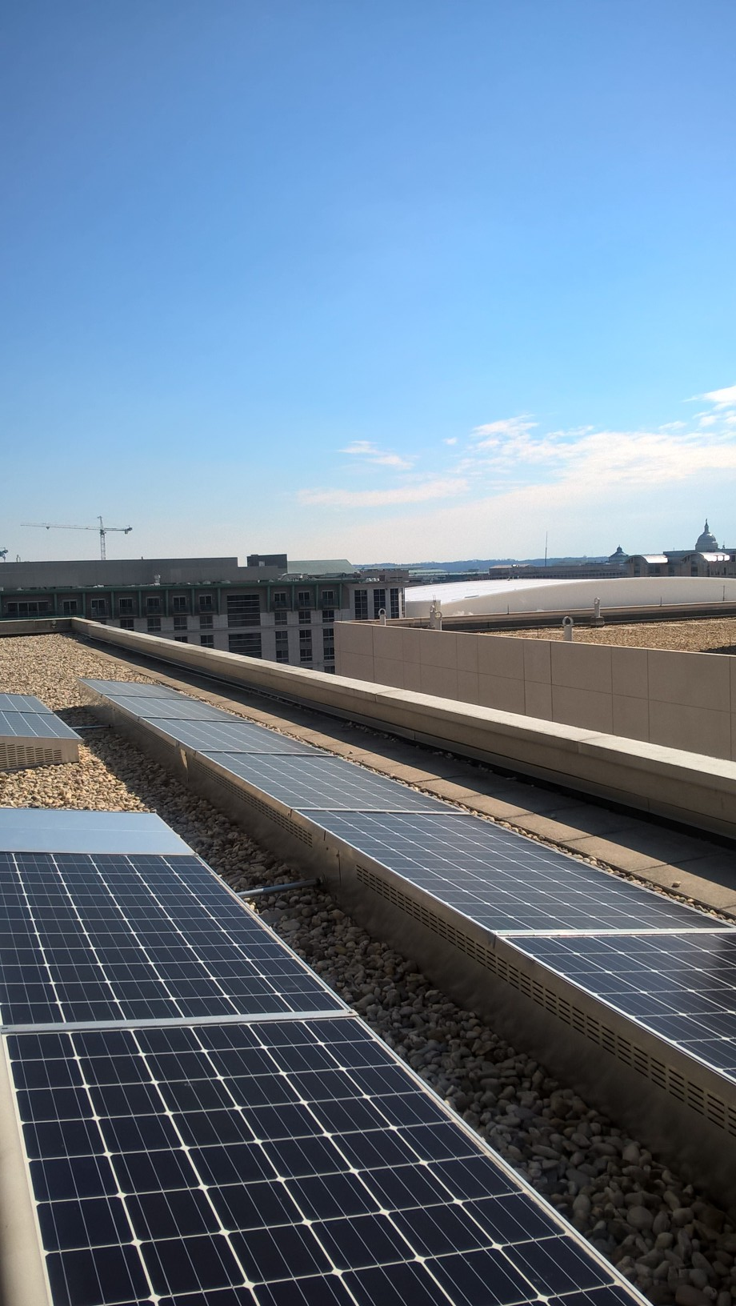
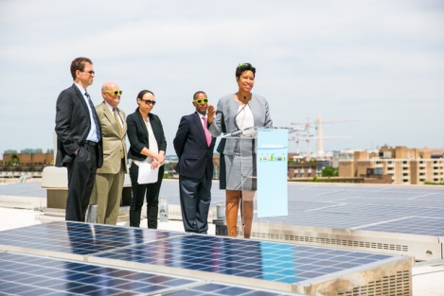
OTHER GRANTS
Weatherization + Solar Grant: $2.4 M for weatherization, roof repair, and solar installation at DCHA’s Garfield Terrace property.
Vulnerability Assessment and Resilience Audit Grant: $250,000 solar tool for affordable housing led by Enterprise Community Partners.
@DOEE_DC

Slide 13
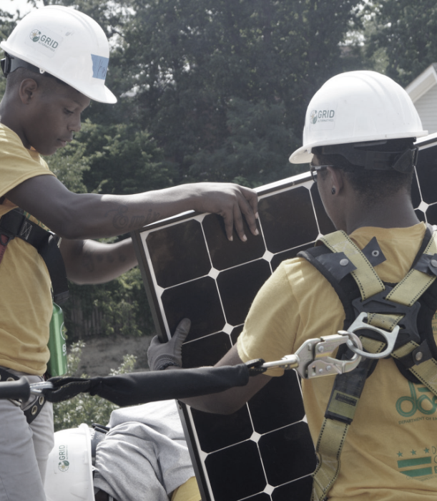
Job-Training for careers
3 cohorts/year
75 trainees
Solar for DC residents
Installations on 60-100 low-income, single family homes
Partnering with local NGOs
Training by Grid Alternatives Mid-Atlantic
@DOEE_DC

Slide 14
Agencies and institutions
NAME | AMOUNT | DESCRIPTION
D.C. Housing Authority | $5M | Roof repair and replacement, and solar and battery storage at DCHA properties.
D.C. Public Library | $1M | Solar + Battery project at the Southwest Branch public library to increase resiliency for the neighborhood.
@DOEE_DC

Slide 15
LEAD BY EXAMPLE: DOEE & DGS
NAME | AMOUNT | DESCRIPTION | CAPACITY
Oxon Run | $3.5M | Community Solar proposed at Oxon Run, a brownfield. Bill credits will be provided to approximately 350 households in the neighborhood. | 1 - 1.4 MW
Solar + Battery Assessment | $150k | Assess DGS facilities for opportunities to deploy solar plus battery storage for resiliency and demand response scenarios. | N/A
THE SMITHS’ HOUSE
JOHN’S HOUSE
MR. MILLER’S HOUSE
YOUR HOUSE
@DOEE_DC

Slide 16
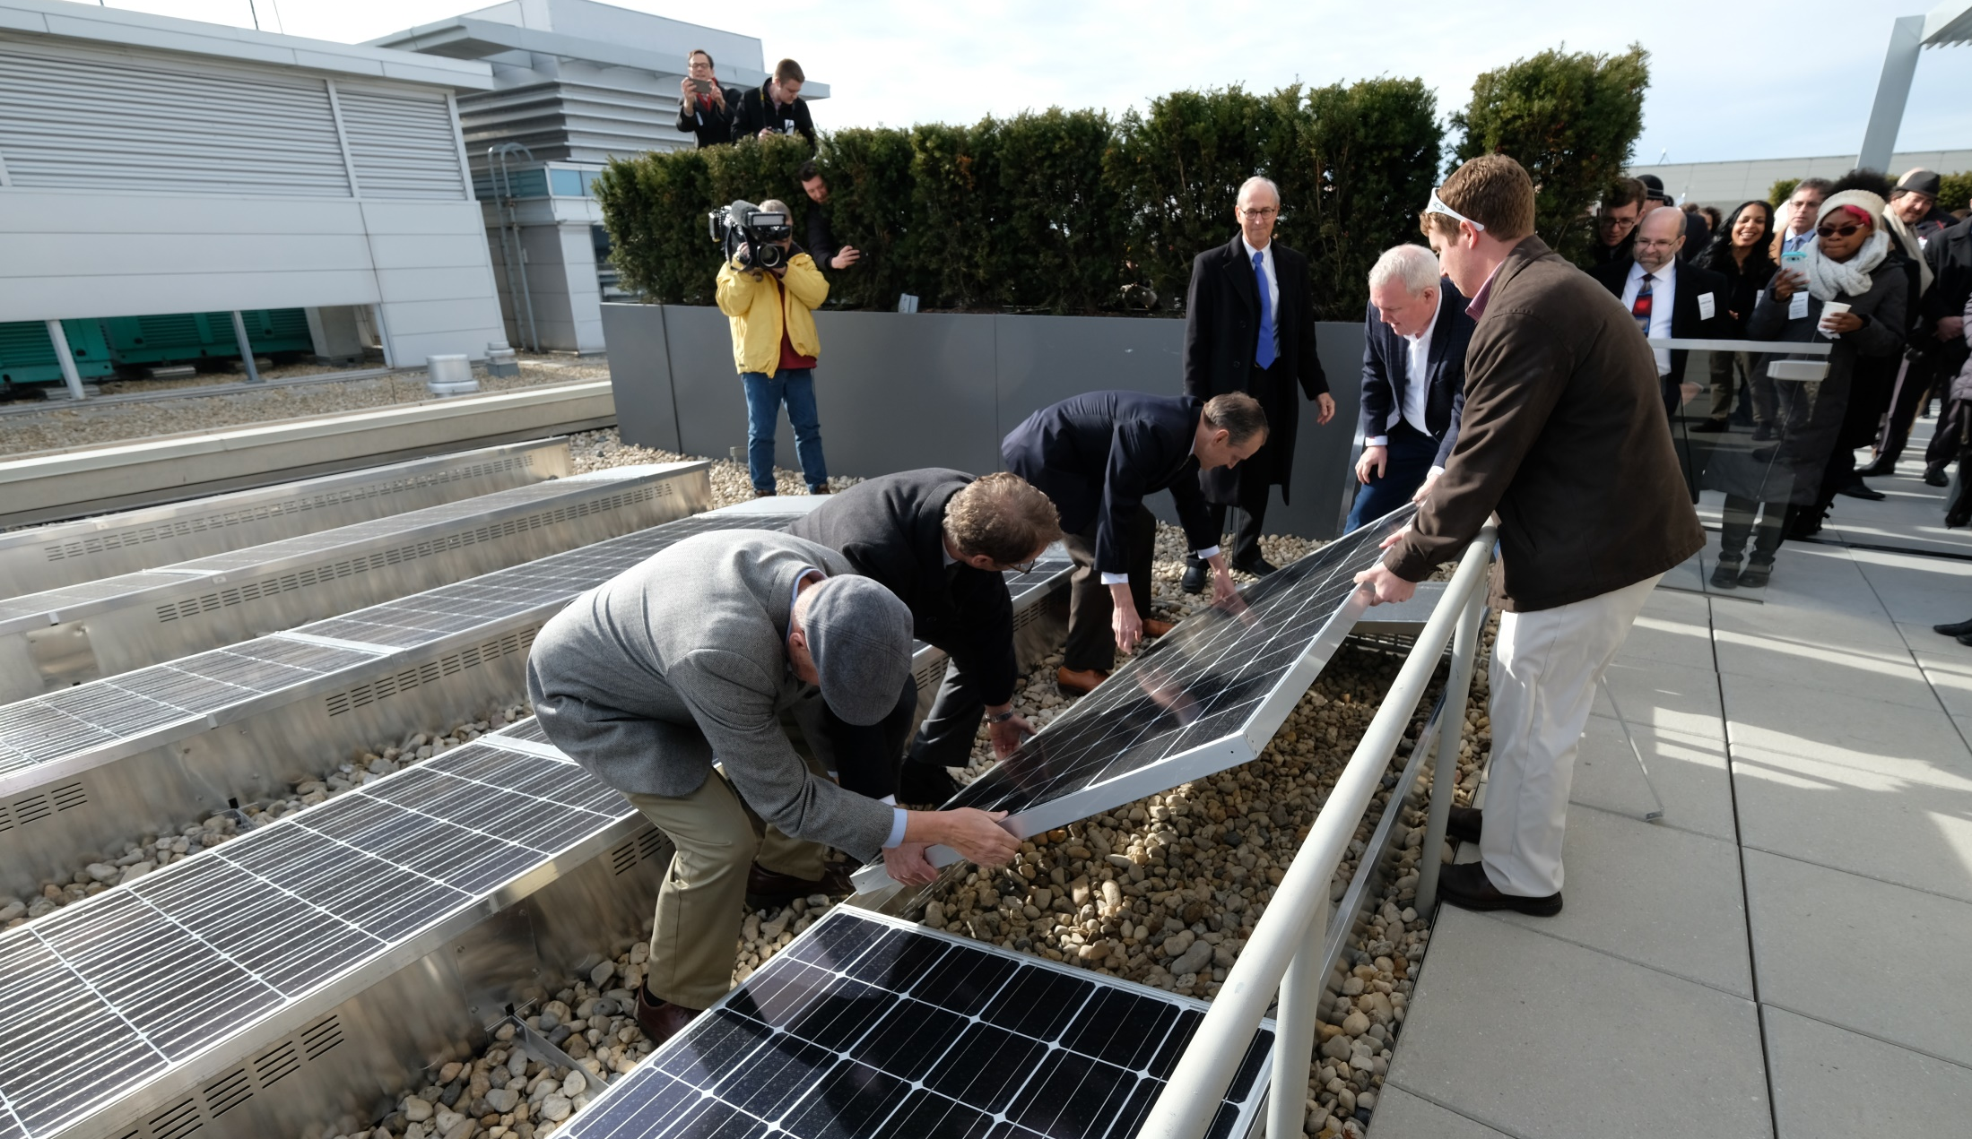
WHAT’S NEXT FOR SOLAR FOR ALL
@DOEE_DC
Notes:
16

Slide 17
Notes:
Image source:https://www.energy.gov/articles/quiz-test-your-solar-iq

