Slide 2
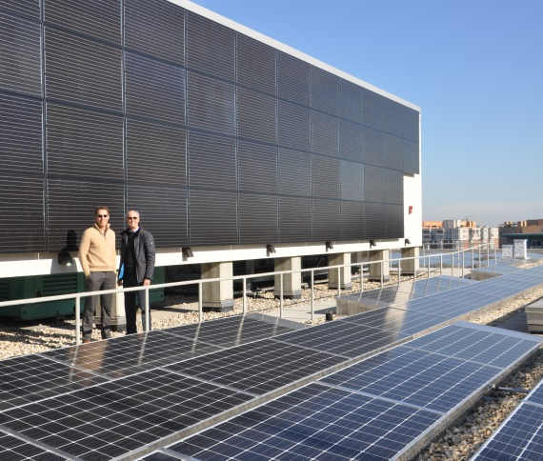
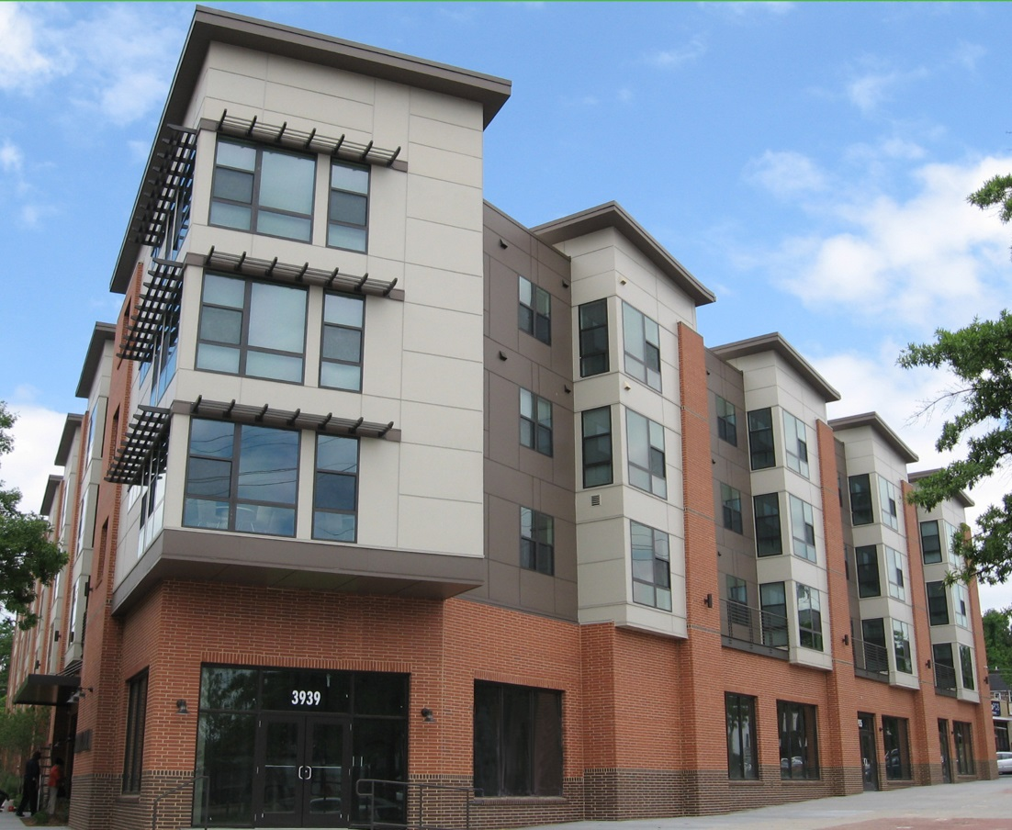
Energy here Used there
Office building delivers electricity to utility
Utility gives residents a credit each month on their electric bills
PEPCO

Slide 3
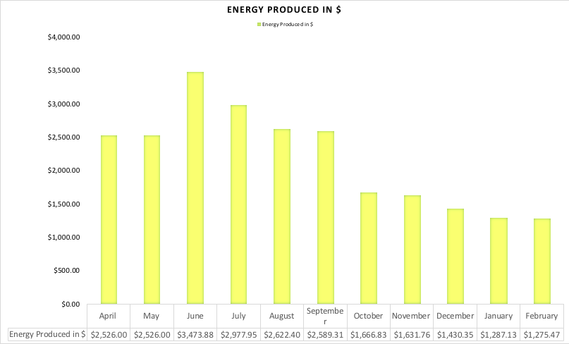
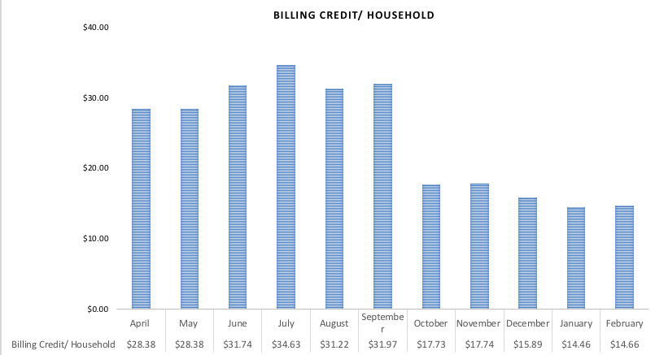
Impact and Energy Produced

Slide 4
Challenge: SREC Market
Tax equity
Debt
Grants
Tax equity: energy tax credits (federal subsidy)
Debt: SRECS (state subsidy) and loan
Grants: DC government

Slide 5
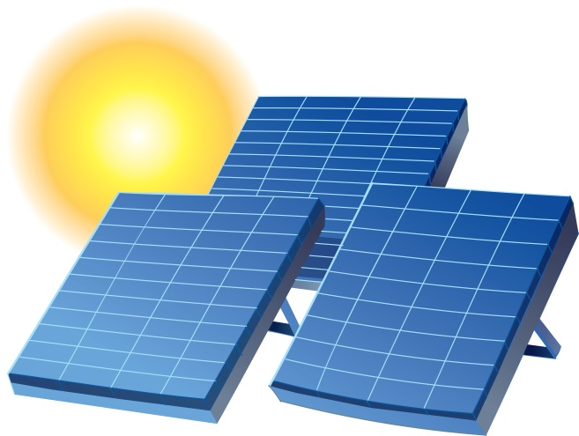
Community Solar Finance Structure
Grants
New Partners Community Solar Corp.
DC Residents
Funds loaned to Project Company to install solar panels
Nonprofit manager
Tax Equity Investor
PEPCO
Bank
Pepco allocates billing credits to low-income residents in DC
Company sells SRECs to pay expenses and debt service on loan
Project Company
Owns panels
Project Company sends energy from solar panels to the grid
SREC Purchaser
Facility qualifies as Community Renewable Energy Facility under Community Solar Law
Building Owner
License for roof space

Slide 6
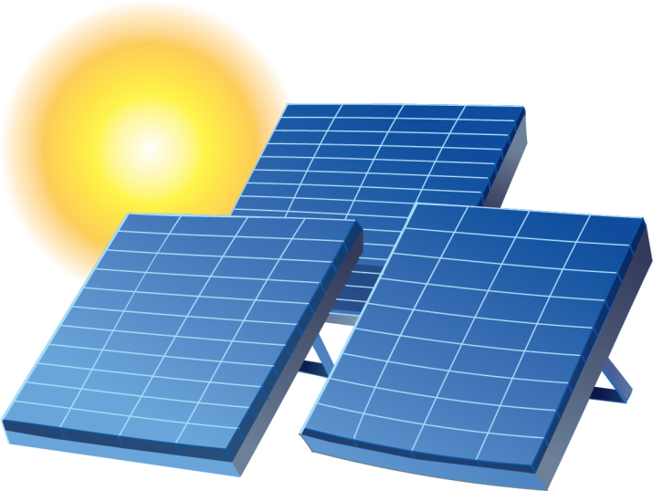
Challenge: Interconnection
How Community Solar Works
1. Solar Panels
Sunlight falls on solar panels. The solar panels convert the sun’s energy into direct current (DC) electricity which is sent to an inverter.
2. Inverter
The inverter converts direct current (DC) electricity into alternating current (AC) so it can be used in our homes and businesses.
3. Meter
The meter measures the amount of electricity produced by the solar panels before the electricity is fed into the utility grid.
4. Utility Company
The utility company keeps track of how much electricity (how many kilowatt-hours) is fed into the grid generated by the solar panels.
5. Utility Bill
The utility does not deliver the actual electricity from the grid to individual customers. Instead it calculates the value of this electricity and provides a cash credit on the specified customer’s monthly electric bill. The customer may live nearby or across the city.

Slide 7
Challenge: Commercial Rooftop Owners – Competing Interests and Possibility of Removal

