Slide 1

SOLAR JOBS: OHIO’S NEW ECONOMY AND THE IMPACTS OF POLICY
Gilbert Michaud, Ph.D.
Assistant Professor of Practice
Voinovich School of Leadership and Public Affairs
Prepared for the Ohio Solar Congress – March 2018

Slide 2
REGULATORY OVERVIEW
Net Metering (1999)
  Credits energy owners for adding electricity back to the grid
  Net Metering (FTG -> A…since 2010)
Renewable Portfolio Standard (2009)
  Requires utilities to generate a proportion of their total output from renewable sources. 12.5% by 2027, 0.5% PV carveout
  Freeze in 2014, Expired in 2016. HB 114 proposed to make goals voluntary
  Impacts to Solar Renewable Energy Credits (SRECs)
Solar Tariff (2018)
  30% in 2018, 25% in 2019, 20% in 2020, and 15% in 2021
  First 2.5 GW of imported solar cells are exempt from the tariff each year

Slide 3
OHIO UTILITY AND DISTRIBUTED SOLAR CAPACITY,
2009-2016
Note. Figure created by author with data from the U.S. Energy Information Administration.
Notes:
Less than 1% of total generating capacity in the state. 140 MW in 2016, 175 MW in 2017.

Slide 4
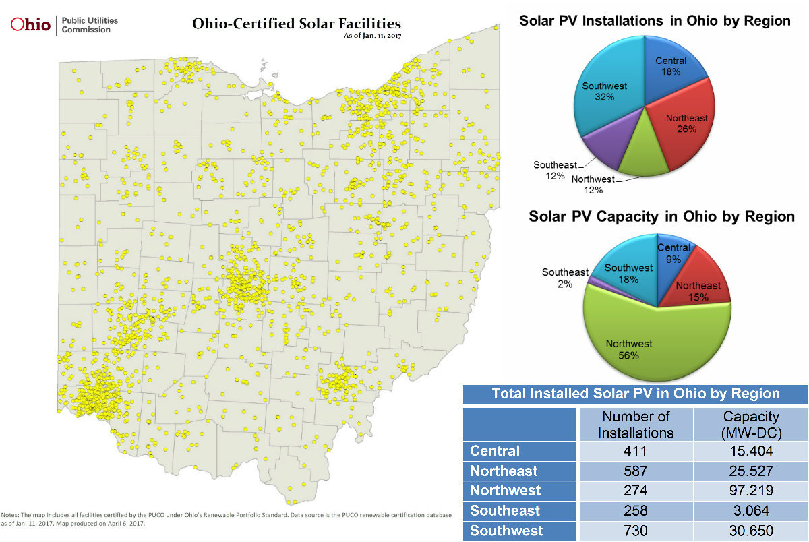
PUCO-CERTIFIED SOLAR ENERGY FACILITIES, 2017
Source: Green Energy Ohio. (2017). http://www.greenenergyoh.org/

Slide 5
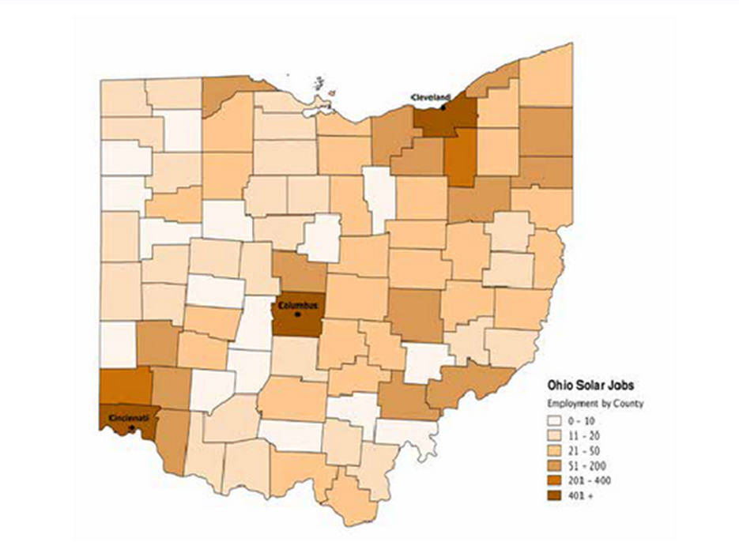
OHIO SOLAR COUNTIES BY EMPLOYMENT, 2016
Source: The Solar Foundation (2016). https://www.thesolarfoundation.org/solar-jobs-census/solar-jobs-compendium-oh/

Slide 6
OHIO SOLAR AND WIND INDUSTRY EMPLOYMENT,
2013-2016
Solar = 11.3% Growth Rate
5,831 Jobs in 2016
Note. Figure created by author with data from The Solar Foundation, Green Energy Ohio, Clean Jobs Ohio, and Clean Jobs Midwest
Notes:
The Solar Foundation --- surveys hundreds of thousands of known energy establishments, resulting in completed surveys from more than 2,000 solar establishments The Solar Foundation. (2016a). About The Solar Foundation. Retrieved from http://www.thesolarfoundation.org/about-the-solar-foundation/

Slide 7
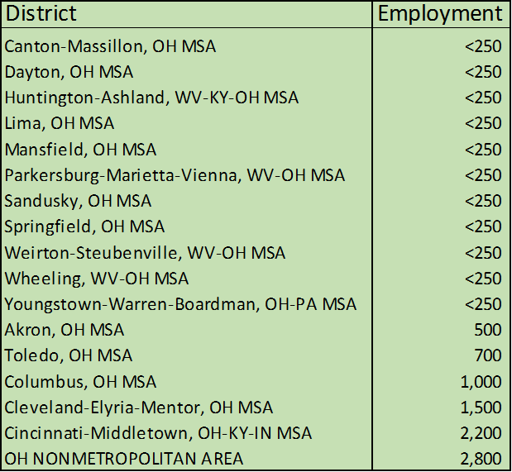
RENEWABLES EMPLOYMENT BY GEOGRAPHY, 2016
Source: Clean Energy Trust and Environmental Entrepreneurs (E2).
Notes:
Solar, wind, and geothermal

Slide 8
TRANSITIONING EMPLOYMENT
Skillshed Project (EDA)
  Mapping 2014-2024
  124 struggling coal occupations (average = $27/hour)
    33% of coal jobs require a bachelor’s degree
  27 growing solar occupations (average = $34/hour)
    60% of solar jobs require a bachelor’s degree
  There is a skills gap

Slide 9
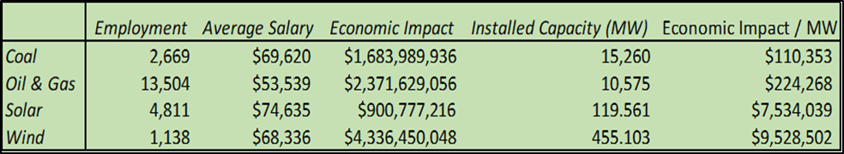
OHIO ENERGY INDUSTRY ECONOMIC IMPACT, 2015
Note. Author calculation from IMPLAN Version 3.1

Slide 10
OHIO SOLAR INDUSTRY ECONOMIC IMPACT, 2015
Impact Type | Employment | Labor Income | Value Added | Output
Direct Effect | 4,811 | $574,442,156 | $820,411,647 | $900,777,216
Indirect Effect | 452 | $24,207,071 | $42,964,182 | $76,109,451
Induced Effect | 4,084 | $174,944,694 | $321,326,039 | $559,023,410
Total Effect | 9,347 | $773,593,922 | $1,184,701,868 | $1,535,910,078
MULTIPLIER | 1.94 | 1.35 | 1.44 | 1.71
Note. Author calculation from IMPLAN Version 3.1
Notes:
5,831 jobs in 2017 = over 13,000 total jobs throughout the multiplier effect.

Slide 11
AEP OHIO’S 400/500 MW PLAN
 |  | Jobs | Annual Salary | Economic Impact
Solar | Construction | 2,220 | $88,724 | $406,317,278
 | O&M | 1,271 | $65,452 | $139,346,377
 | Total/Average | 3,491 | $80,250 | $545,663,655
Wind | Construction | 2,002 | $57,410 | $289,649,179
 | O&M | 126 | $57,066 | $29,194,259
 | Total/Average | 2,128 | $57,389 | $318,843,438
Note. Author calculation from NREL’s JEDI model
Notes:
Last year, the PUCO approved a plan for AEP Ohio to install 500 MW of wind capacity and 400 MW of solar capacity
Site preference for solar projects in Appalachian Ohio

Slide 12
OTHER CONFOUNDING FACTORS
Tax credits
  Federal is scaling down and expiring; no state tax credit in OH
  With tax credits, results suggest an additional 37.8 MW would have been installed in 2013 (0.326 MW per 100,000 times 115.9)
Low solar insolation resources (44th at 3.8 kWh/m²/day)
Relatively low electricity costs (22nd at 9.84 cents/kWh)

Slide 13
CONCLUSIONS
RPS freeze hurt renewable industries
  Cost of SRECs fluctuates, IOUs buys large amounts when cost drops and can ‘bank’ extra credits for future years
Ohio’s favorable net metering policies helped facilitate PV deployment and should be protected
What about the tariff?? (net loss of 23,000 jobs in 2018?)
“The State of the Energy Industry in Ohio: Job Trends and Projections” (https://www.ohio.edu/ce3/resources/upload/GVS-White-Paper-State-of-Energy-Industry-in-Ohio-Michaud-et-al-Oct-2017.pdf)
For additional questions/comments, email me at michaudg@ohio.edu

Slide 14
PANEL DISCUSSION WITH SOLAR INSTALLERS
Candice Brothers – YellowLite
David Zelasko – Third Sun Solar
PLEASE ASK QUESTIONS!!

